Slide 1
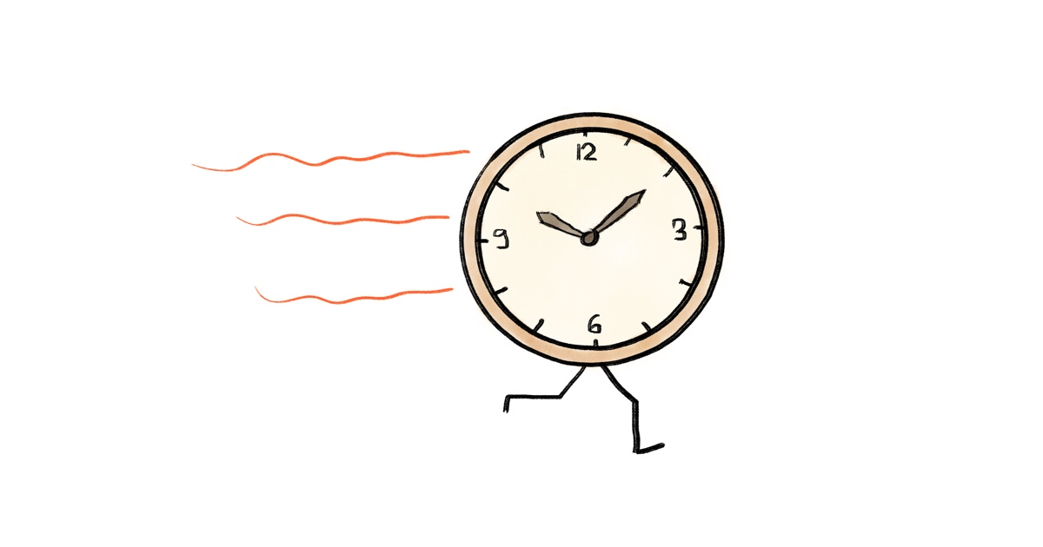
Time Management By- Ankit, Vidhi, Apeksha and Rashmi

Slide 2
CONTENT
Why we do need time management?
Introduction to time management
Benefits of time management
Tips To Manage Time

Slide 3

Why we do need time management?
To save the time
To reduce the stress
To function effectively
To increase our work output
To have more control over our job responsibilities

Slide 4
Introduction to time management
Managing time effectively so that the right time is allocated to the right activity
The act of taking control over the amount of time spent on specific activities
Making the best use of time, as time is always limited

Slide 5


Time Management tips
Set Goals Correctly
Prioritize Wisely

Slide 6
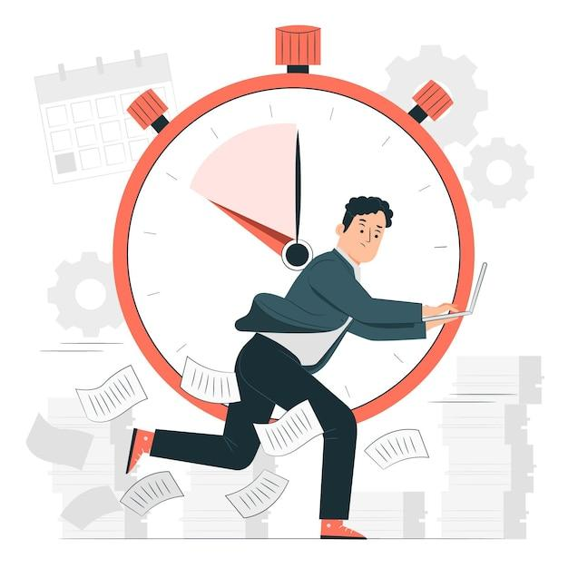

Set a time limit
Take a Break between Task

Slide 7
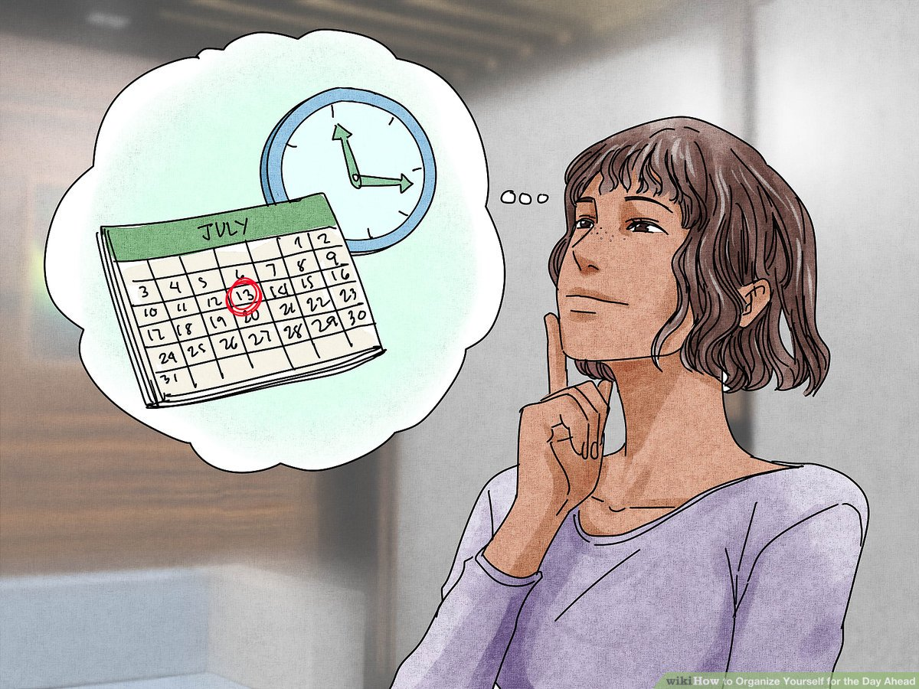

Organize Yourself
Plan Ahead

Slide 8


Conclusion
Log activities
List of tasks
Set priorities.
Schedule your time.
Do first things first.
Review each day.

Slide 9
References:
https://corporatefinanceinstitute.com/resources/careers/soft-skills/time-management-list-tips/
https://www.indeed.com/career-advice/career-development/benefits-of-time-management

Slide 10


